Slide 1

Recurrent Endometrial Cancer Scott Glaser, MD - @DocGlaser City of Hope National Medical Center

Slide 2
Disclosures
Employed at City of Hope
Gynecology Co-Chair of Elsevier Clinical Pathways

Slide 3
Learning Objectives
Distinguish the various types of endometrial cancer recurrence
Identify appropriate therapy for recurrent endometrial cancer based on tumor size, location, and extent
Prepare patients for what to expect with therapy including offering appropriate guidance on outcomes and prognosis

Slide 4
How Does Endometrial Cancer Recur?
Distant Metastases
Oligometastatic
Polymetastatic
Locoregional
Vaginal cuff
Supravaginal
Vaginal mucosa
Vaginal
+/- Lymph node involvement
Nodal only recurrence

Slide 5
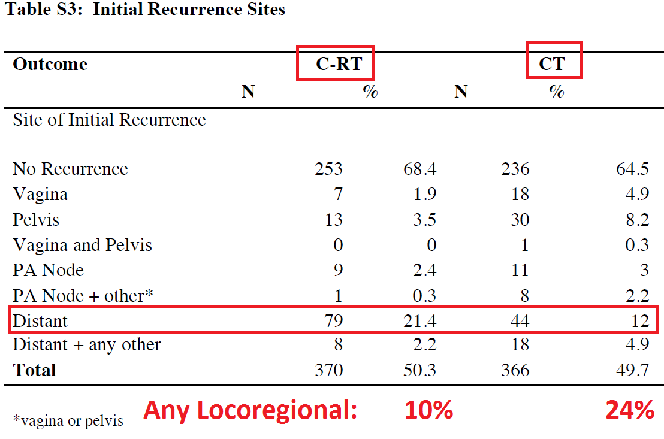
Patterns of Recurrence
Early stage
1A G1-2
1-3% chance of recurrence (Sorbe et al)
High-Intermediate Risk
No RT (Portec 1, GOG 99) = 10-40% risk of recurrence LR recurrence
75% of recurrences at vaginal cuff
With Vag Cuff Brachy (Portec 2)
Vaginal = 3%
Pelvic = 6% (1% with EBRT)
EBRT reduces pelvic recurrences for:
Substantial LVSI, L1CAM, p53
Locoregionally Advanced
GOG 258:

Slide 6
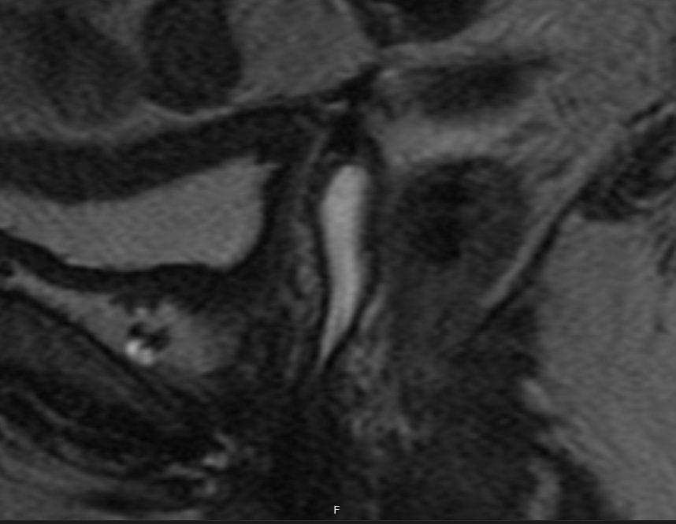
Case 1
64 yo, IAG1 endometrial adenocarcinoma
TAH-BSO & PLND, no adjuvant therapy
2 years later 2mm erythematous lesion noted at vaginal cuff on exam
Biopsy + for recurrence
PET/CT: No regional or distant disease
Brachytherapy choice
Poll

Slide 7
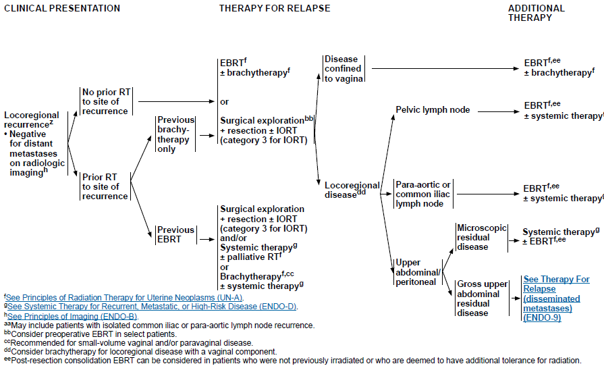
NCCN Guidelines

Slide 8
Radiation Plan
EBRT 45-50 Gy to the pelvis and vagina
Half of experts treat whole vagina for upper vaginal recurrence, half treat with 3-4 cm margin
Treat whole vagina if mid to distal vaginal involvement
Brachytherapy boost
Intracavitary or interstitial
Interstitial recommended if remaining disease >0.5 cm thick
5-6 Gy per fraction x 4-5 fractions
Total dose of 70-85 Gy EQD2
Dose Constraints
Rectum and/or sigmoid: D_{2cc} <70-75 Gy EQD2
Bladder: D_{2cc} <80-90 Gy EQD2
Small Bowel: Max <60-65 Gy EQD2
No consensus for urethra, ureter, vagina
Beriwal S, Demanes D, Erickson B, et al. American Brachytherapy Society consensus guidelines for interstitial brachytherapy for vaginal cancer. Brachytherapy. 2012;11:68-75.
Kamrava M, Beriwal S, Erickson B, et al. American Brachytherapy Society recurrent carcinoma of the endometrium task force patterns of care and review of the literature. Brachytherapy. 2017;16:1129-1143.

Slide 9
Brachytherapy Options (Vaginal Cylinders)
Single Channel Vaginal Cylinder Brachytherapy (SCVCB)
Limited to instances where entire circumference of vagina should receive same dose
E.g. apical recurrences with residual thickness ≤5 mm
Shielding may be employed to restrict dose to particular region
Multi-Channel Vaginal Cylinder Brachytherapy (MCVCB)
Size cutoffs of 5 mm for apical or posterior lesions and 7 mm for other locations as long as OAR constraints are met.
Glaser SM, Beriwal S. Brachytherapy for malignancies of the vagina in the 3D era. J Contemp Brachytherapy. 2015;7:312-318.

Slide 10
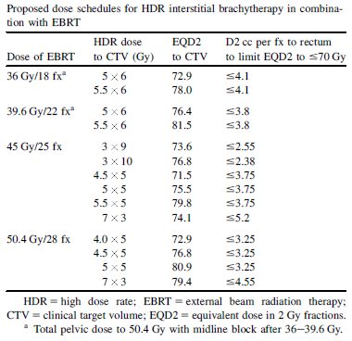
Brachytherapy Options (Interstitial)
Interstitial Brachytherapy
Useful for lesions not amenable to treatment with SCVCB or MCVCB
lesions >0.5mm thick
Supravaginal recurrences
Frequently utilize perineal template with vaginal cylinder
Needles should extend 5-10 mm beyond tumor, <10 mm between needles
laparoscopic guidance encouraged in post-hysterectomy patients
MRI helpful in CTV delineation (pre or post implant)

Slide 11
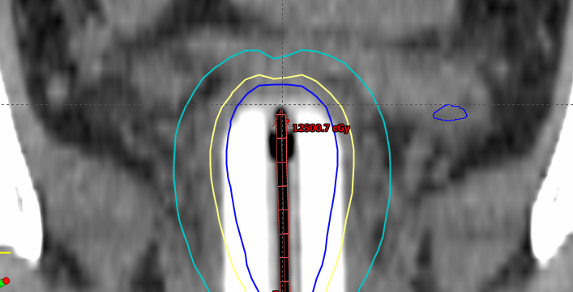
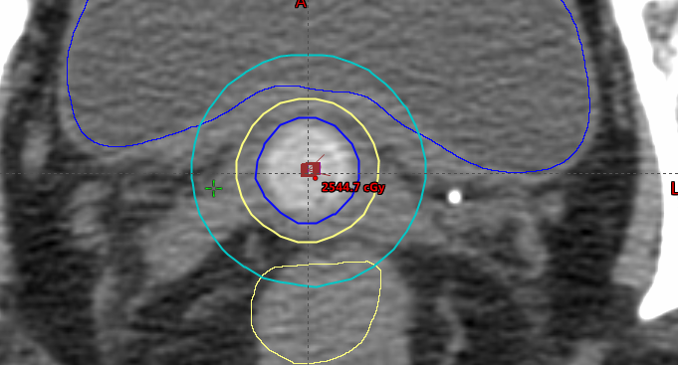

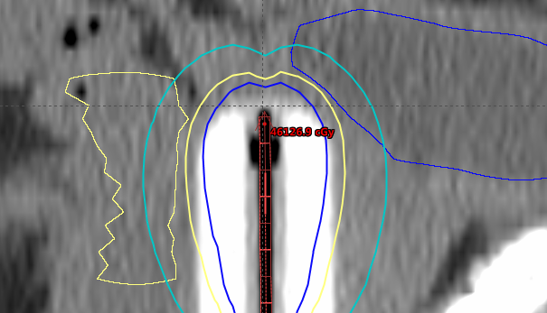
Case 1

Slide 12

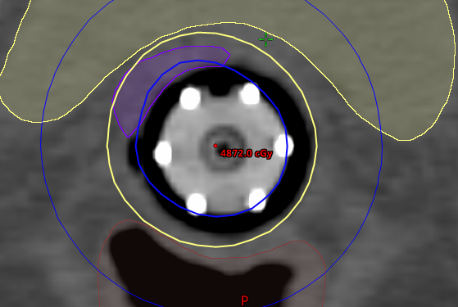
MCVC for residual disease after EBRT
(GTV Purple)

Slide 13
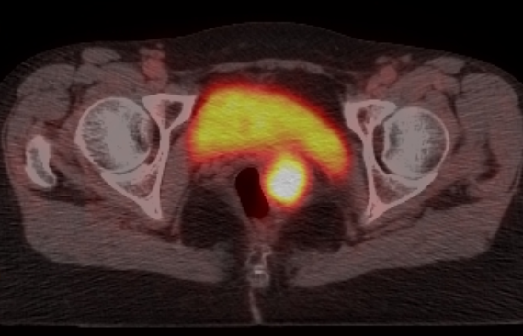
Case 2
63 yo, IAG1 endometrial adenocarcinoma
TAH-BSO & PLND, no adjuvant therapy
5 years later vaginal bleeding found to have mass
Biopsy + for recurrence
PET/CT: No regional or distant disease

Slide 14
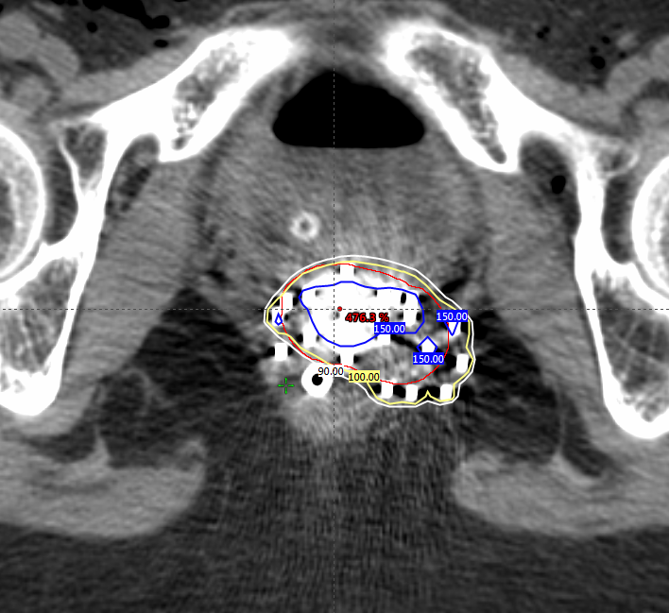
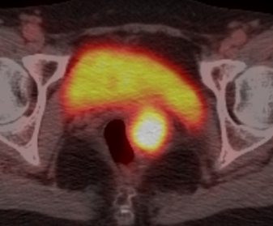

Case 2 - Interstitial
Pre
Post

Slide 15
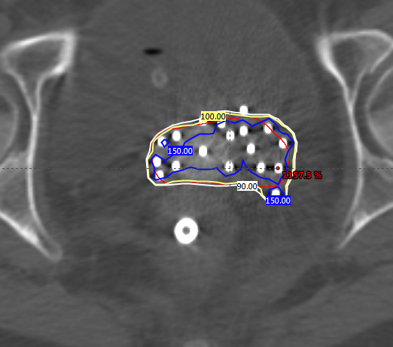
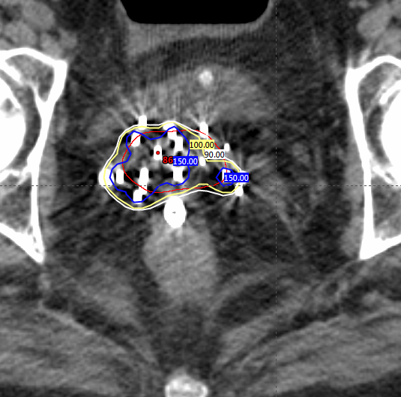
Other Interstitial Examples

Slide 16
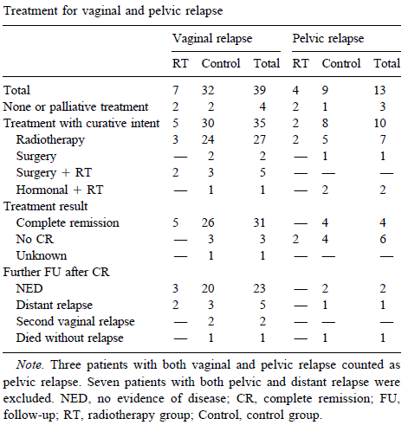
Outcomes and Prognosis
Analysis of PORTEC-1 recurrences:
CR of 89% of patients with isolated vaginal relapse mostly treated with EBRT + brachy
3 yr survival
vaginal relapse: 73%
Nodal relapse: 8%
Distant relapse: 14%
3 yr survival
without prior RT: 51%
With prior RT: 19%
Creutzberg C, van Putten W, Koper P, et al. Survival after relapse in patients with endometrial cancer: results from a randomized trial. Gynecol Oncol. 2003;89:201-209.

Slide 17
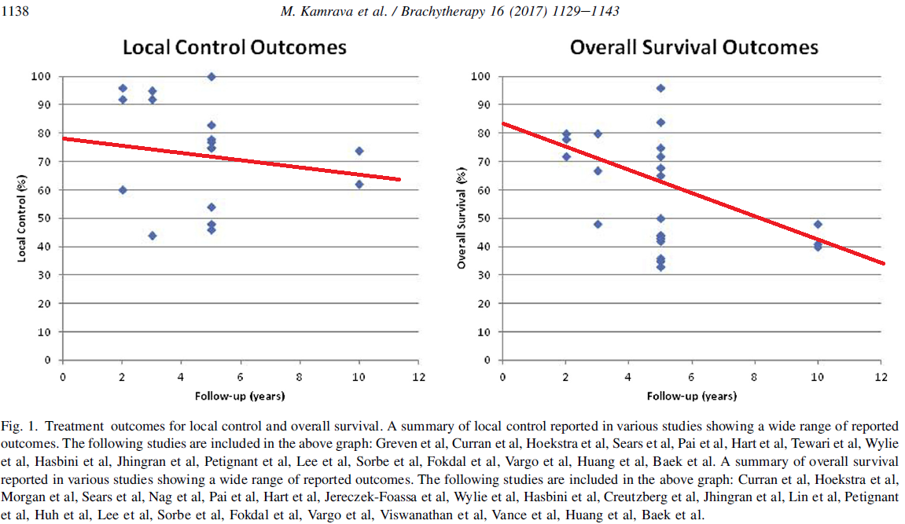
Outcomes and Prognosis

Slide 18
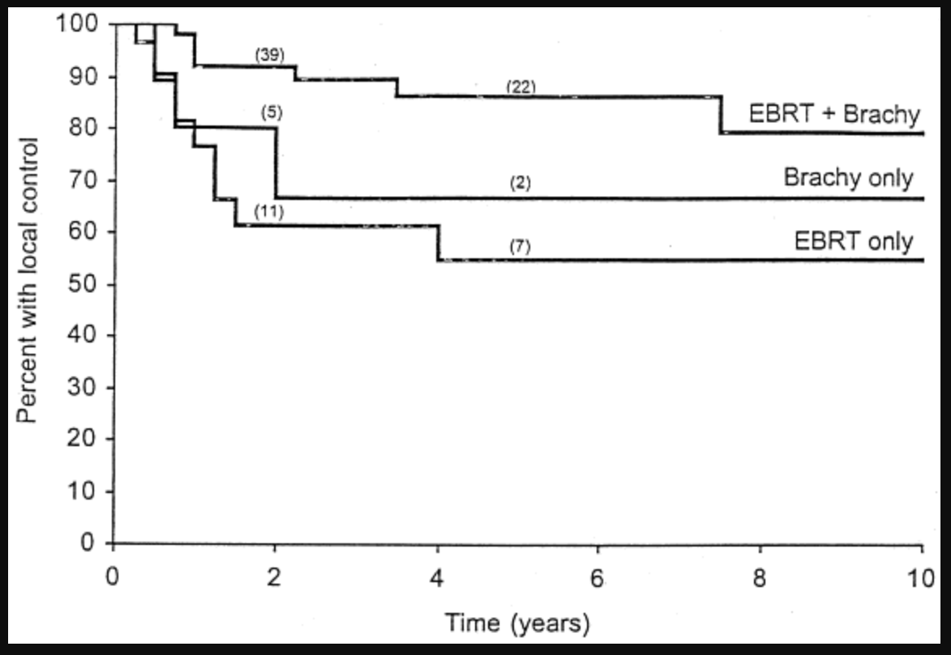
Outcomes and Prognosis
Jhingran A, Burke TW, Eifel PJ. Definitive radiotherapy for patients with isolated vaginal recurrence of endometrial carcinoma after hysterectomy. Int J Radiat Oncol Biol Phys. 2003;56:1366-1372.

Slide 19
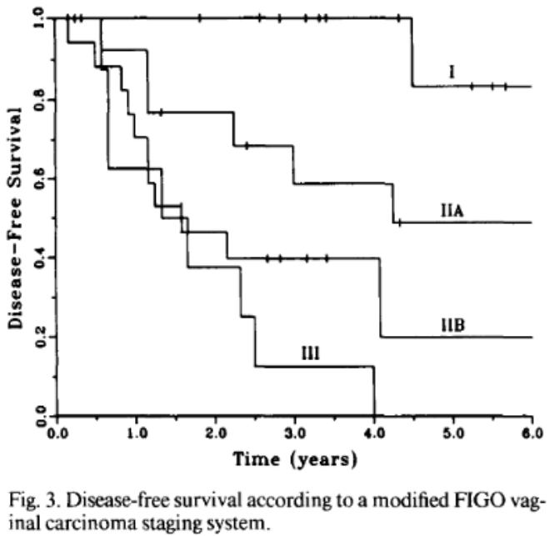
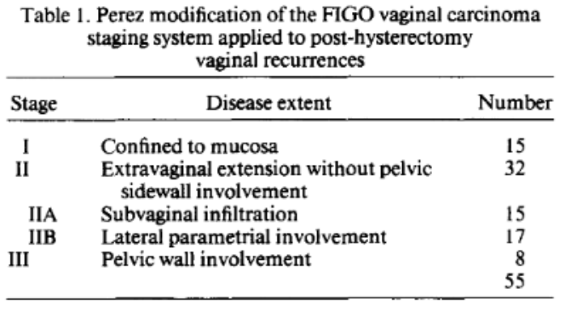
Outcomes and Prognosis
Curran W Jr, Whittington R, Peters A, Fanning J. Vaginal recurrences of endometrial carcinoma: the prognostic value of staging by a primary vaginal carcinoma system. Int J Radiat Oncol Biol Phys. 1988;15:803-808.

Slide 20
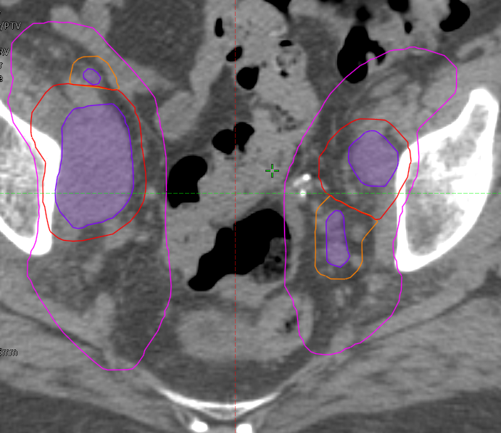
Case 3: Pelvic Nodal Recurrence
79 yo, IBG2 endometrial adenocarcinoma
TLH-BSO, adjuvant brachy 7 Gy x 3 with SCVC
3 years later lower back pain
PET/CT: b/l FDG avid pelvic and paraaortic lymphadenopathy
Biopsy positive for recurrence

Slide 21
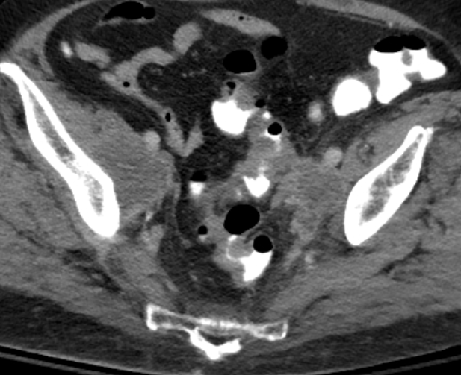
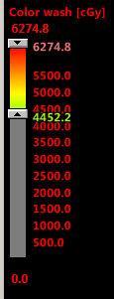
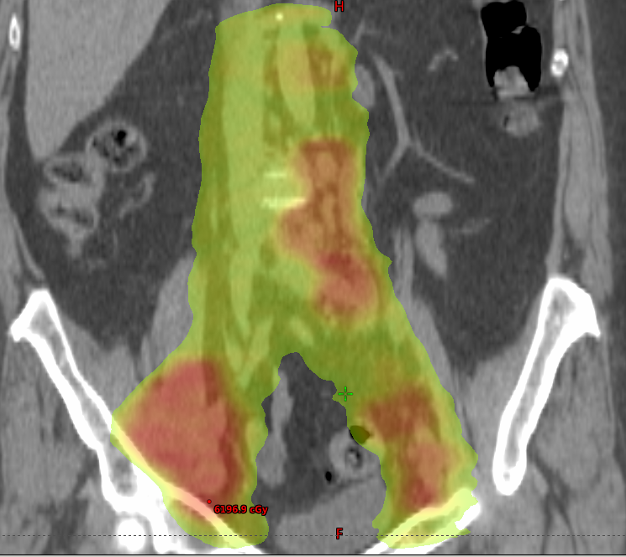
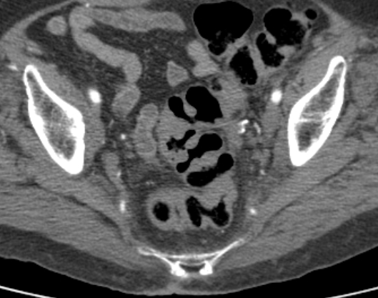
Case 3: Carbo-Taxol x4 followed by Cis-RT
Sept 2019
July 2019
Jun 2020 – PET Negative

Slide 22
Management of Pelvic Only Nodal Recurrences
Definitive IMRT¹
>59 Gy to measurable gross disease
CTV to 45-50 Gy in 1.8-2 Gy per fraction
Median OS of 46.1 months with 2-yr survival of 71%
Median DFS of 20.3 months with 2-yr survival of 47%
¹Ho et al 2015

Slide 23
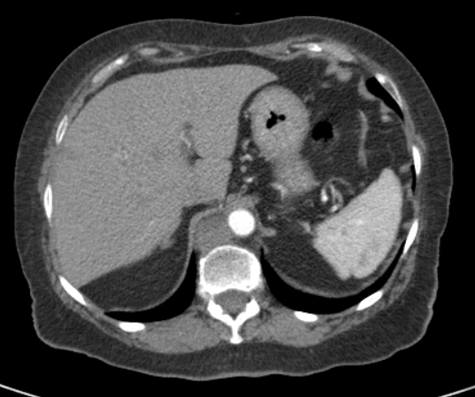
Case 4: Oligometastatic Retrocrural Node Recurrence
Prior stage IIIC2 disease treated with chemotherapy followed by extended field radiation
Only site of disease on PET
SBRT to 40 Gy in 5 fractions

Slide 24
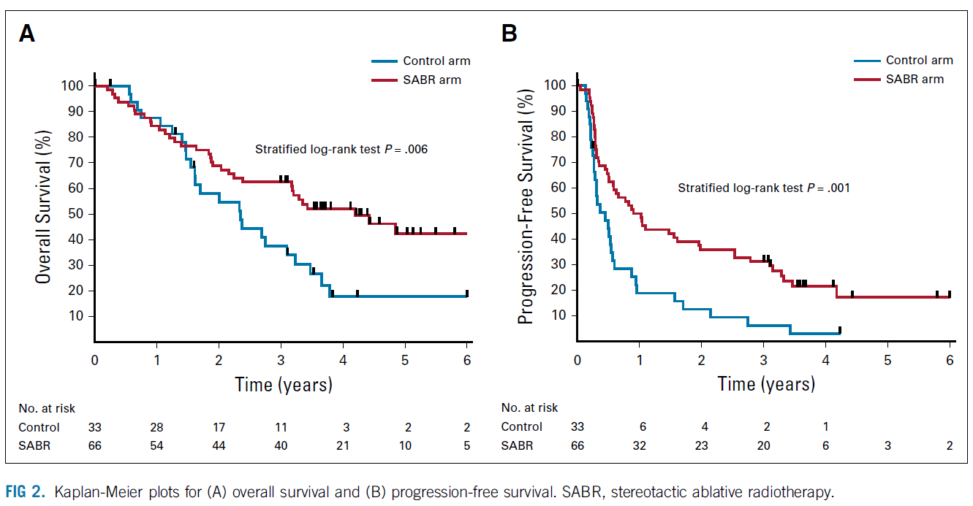
Outcomes and Prognosis for Distant Relapse
Palma D, Olson R, Harrow S, et al. Stereotactic Ablative Radiotherapy for the Comprehensive Treatment of Oligometastatic Cancers: Long-Term Results of the SABR-COMET Phase II Randomized Trial. J Clin Oncol. 2020;38:2830-2838

Slide 25
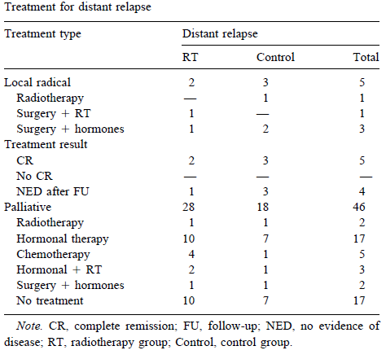
Outcomes and Prognosis for Distant Relapse
Analysis of PORTEC-1 (Creutzberg et al 2003)
5 patients with solitary metastasis to lung, omentum, abdominal wall bone, and brain treated with local surgery or RT.
4/5 NED after follow-up
Patients with multiple metastases had no long-term survival

Slide 26
Role of Chemotherapy
ABS Consensus¹
5/9 routinely recommend
3/9 recommend based on tumor size and grade
Ongoing clinical trial (GOG 238)
Pelvic only recurrences
Pelvic radiation ± weekly cisplatin
¹Kamrava et al, Brachytherapy. 2017

Slide 27
Conclusions
Salvage therapy with EBRT (±concurrent chemotherapy) + brachytherapy for patients with locally recurrent endometrial cancer offers excellent control rates and improvements in survival
Brachytherapy options include SCVCB, MCVCB, and interstitial brachytherapy depending on disease extent and location
Distantly oligometastatic patients may be treated with targeted therapy such as SBRT or surgery with consideration of systemic therapy

